Slide 1
MECHATRONICS COURSE PROJECT
TEAM DETAILS:
NAME | USN
AKASH.R.TAMATE | 01FE19BME157
AMRUTA.M.BALI | 01FE19BME160
ABHISHEK.S.KULKARNI | 01FE19BME139
SHANTHVEER.S.SANKANGOUDAR | 01FE19BME165

Slide 2
NEED STATEMENT:
Water consumption and wastage increases day by day, water Scarcity has become a growing concern around the globe. While Some people are oblivious about the situation. To deal with this, we need a solution that gives data about daily and monthly water consumption of each home to the government to enable proper water distribution.

Slide 3
PROBLEM STATEMENT:
Design a water meter which is apt, modern and smart. The water meter will be cost effective and user friendly. The water meter must measure daily water usage and provides live dater On our phone that is connected to a database, which can be accessed online from any provided region.

Slide 4
COMPONENTS REQUIRED:
SL.NO. | COMPONENT NAME | DESCRIPTION
1. | Node MCU | ESP8266-12E Board
2. | Water Flow Sensor | YF-S201 Hall effect water flow sensor
3. | LCD | 16x2 display
4. | Breadboard | -
5. | Connecting Wires | Jumper wires
6. | Resistors | 10kΩ,4kΩ,1kΩ,2kΩ

Slide 5
Sensor used:
Water Flow Sensor:
The flow sensor is the Position sensor. These are concerned with the determination of the position of some object with reference to some reference point. Water Flow sensor works on the principle of Hall effect Sensor. As we know by the principle of hall effect the voltage can be measured by the current path in this case flow rate/volume can be measured by the water path.

Slide 6
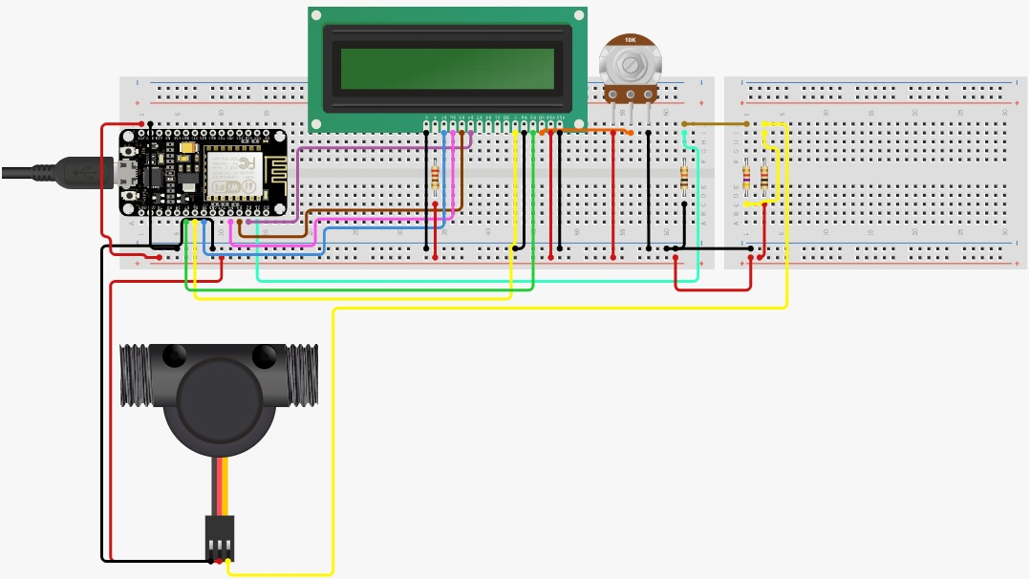
CIRCUIT DIAGRAM:

Slide 7
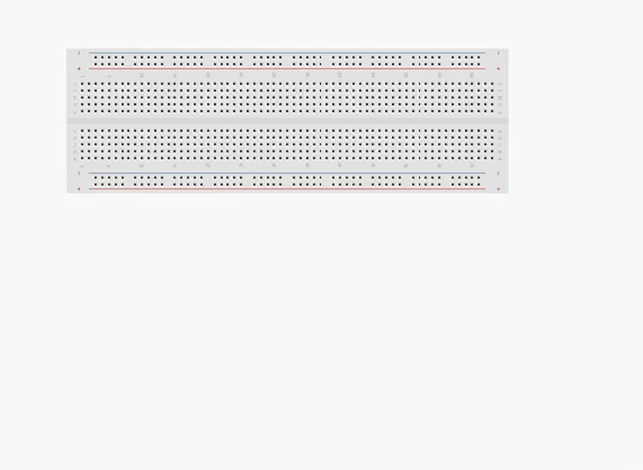
Circuit connection steps:

Slide 8

simulation:

Slide 9
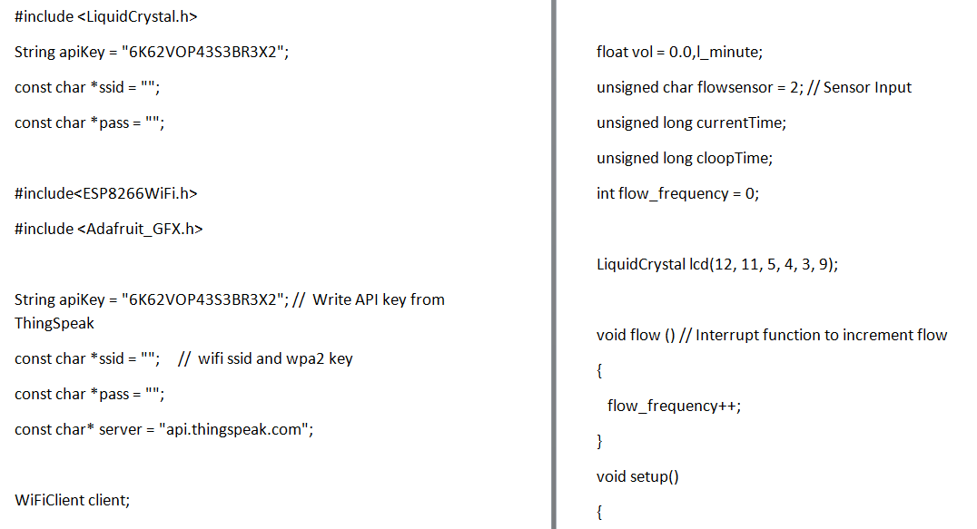
Code:

Slide 10
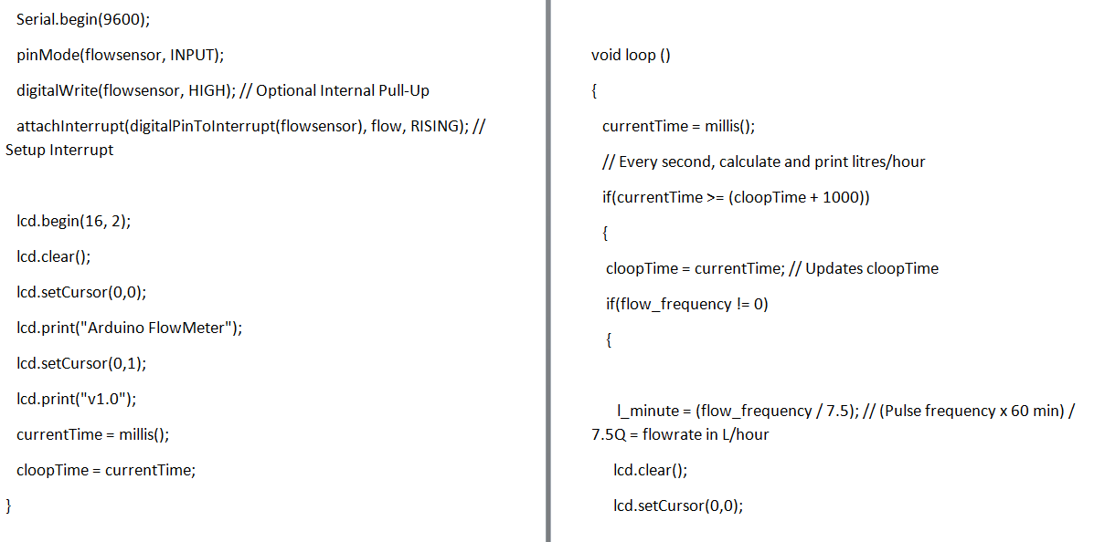

Slide 11
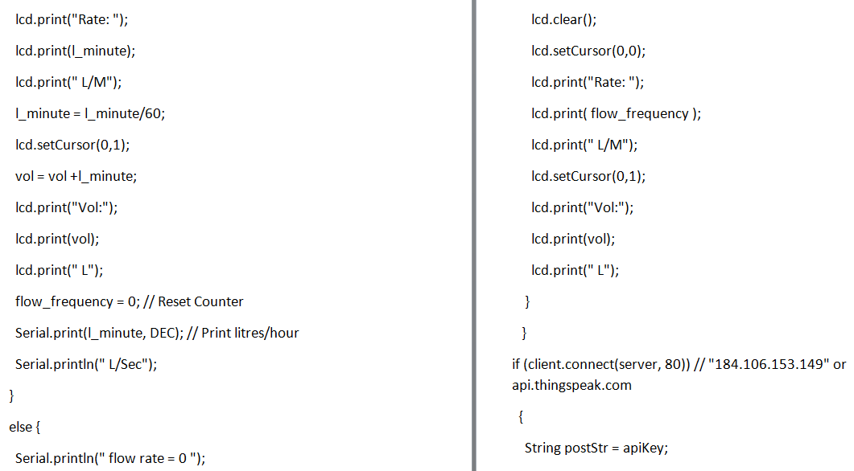

Slide 12
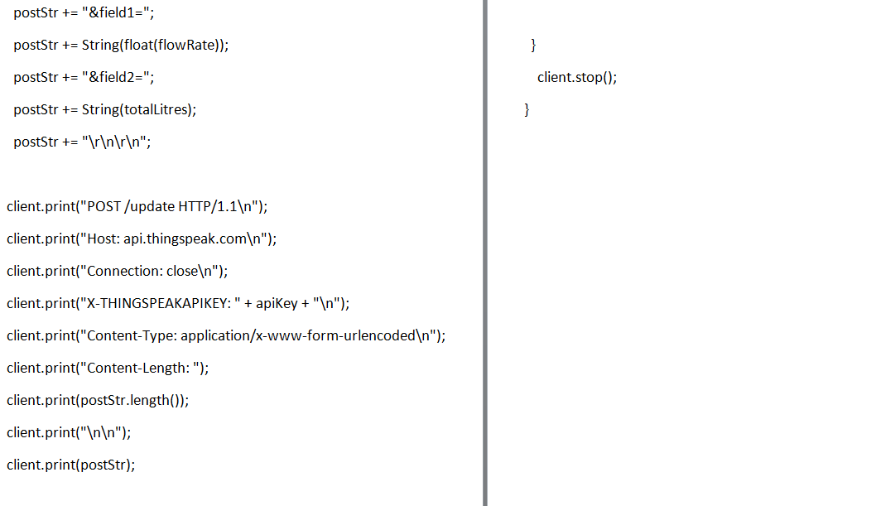

Slide 13
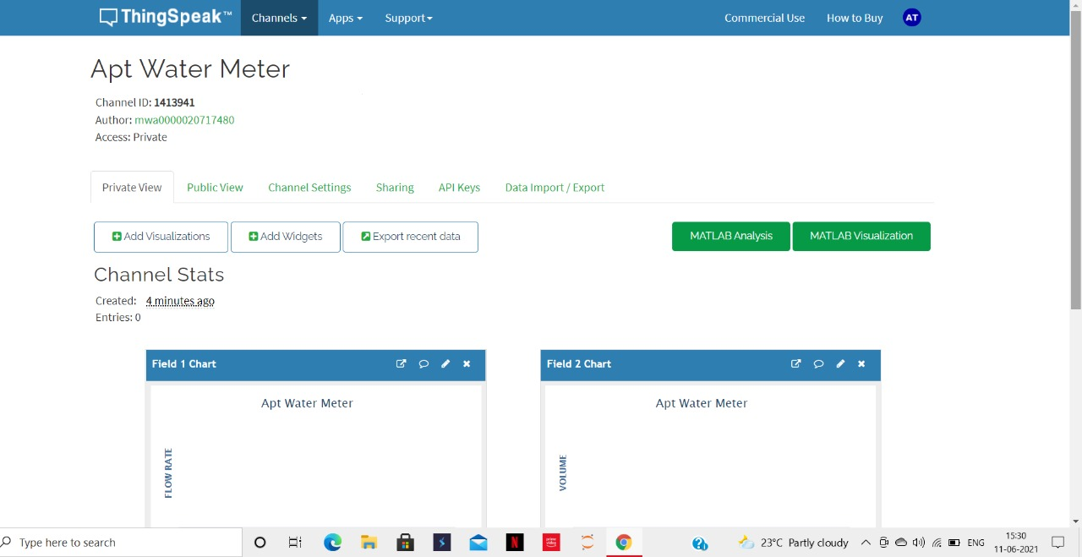
Web server:
https://thingspeak.com/channels/1413941/private_show

Slide 14
Thank you.

